Slide 1
Torque and Slip Behavior of Single-phase Induction Motors Driven from Variable-Frequency Supplies
Author :- Edward Randolph Collins, Member, IEEE
Publication:- IEEE Transactions on Industry Application
DOI: 10.1109/28.137461

Slide 2
Abstract :-
Adjustable-frequency drives (AFDs) haven't been commonly used with single-phase induction motors.
The "volts per hertz" control method for three-phase motors isn't suitable for single-phase motors.
Unlike three-phase motors, single-phase motor slip changes with frequency variations at a constant load.
A constant "volts per hertz" approach offers near-rated torque at high speeds but limited torque below half the base frequency in single-phase motors.

Slide 3
Objectives:-
The objectives of the paper can be summarized as follows:
To understand how the adjustable-frequency drives (AFDs) affect the behavior of single-phase induction motors.
To create control strategies that enable effective speed control of single-phase induction motors using adjustable-frequency drives (AFDs).

Slide 4
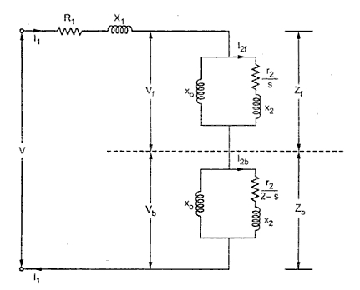
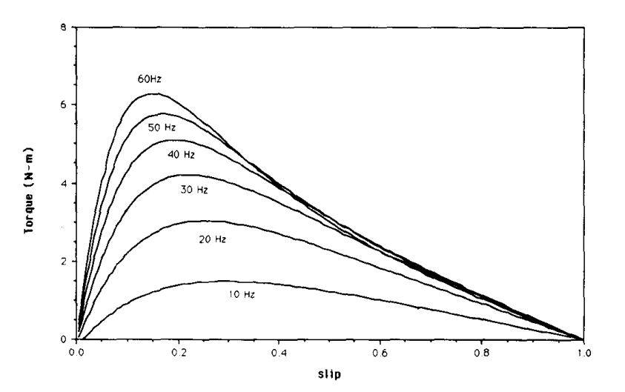
Circuit Diagram :- The circuit diagram for single phase induction induction motor is shown and the torque slip charcteristics corresponding to same V/F ratio at different levels of frequency is shown below

Slide 5
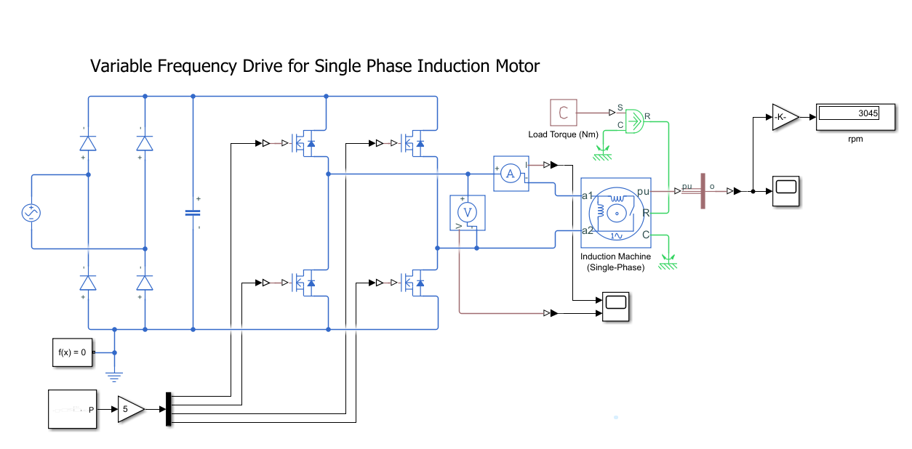
Matlab Simulink :-

Slide 6
Conclusions :-
Standard 3-phase motor control methods are not applicable due to different magnetization behavior. While voltage-frequency control works well at higher speeds, it requires torque derating at lower frequencies.
Restricting stator current and maintaining constant power dissipation offer the best performance for controlling speed at low frequencies.AFDs can be implemented for speed control, but unique characteristics of single-phase motors necessitate distinct control strategies compared to three-phase counterparts.

Slide 7
THANK YOU

